Slide 1
ECE 569A – AI Project Presentation
Knowledge Graph Extraction from Text
Group Members :
Hridya Divakaran V00970167
Kaushik Jeyaraman V00964926
Neeraja Neelakantan V00966268

Slide 2
Problem Statement
Knowledge graph extraction - technique which identifies the entities and relationship between entities from raw unstructured text.
Named Entity Recognition (NER) – Identify the named entities.
1. Bidirectional Long Short Term Memory Network (Bi-LSTM)
2. Conditional Random Fields (CRF)
Relation Extraction – Identify the relation
1. Using BERT model and Softmax Neural Network

Slide 3
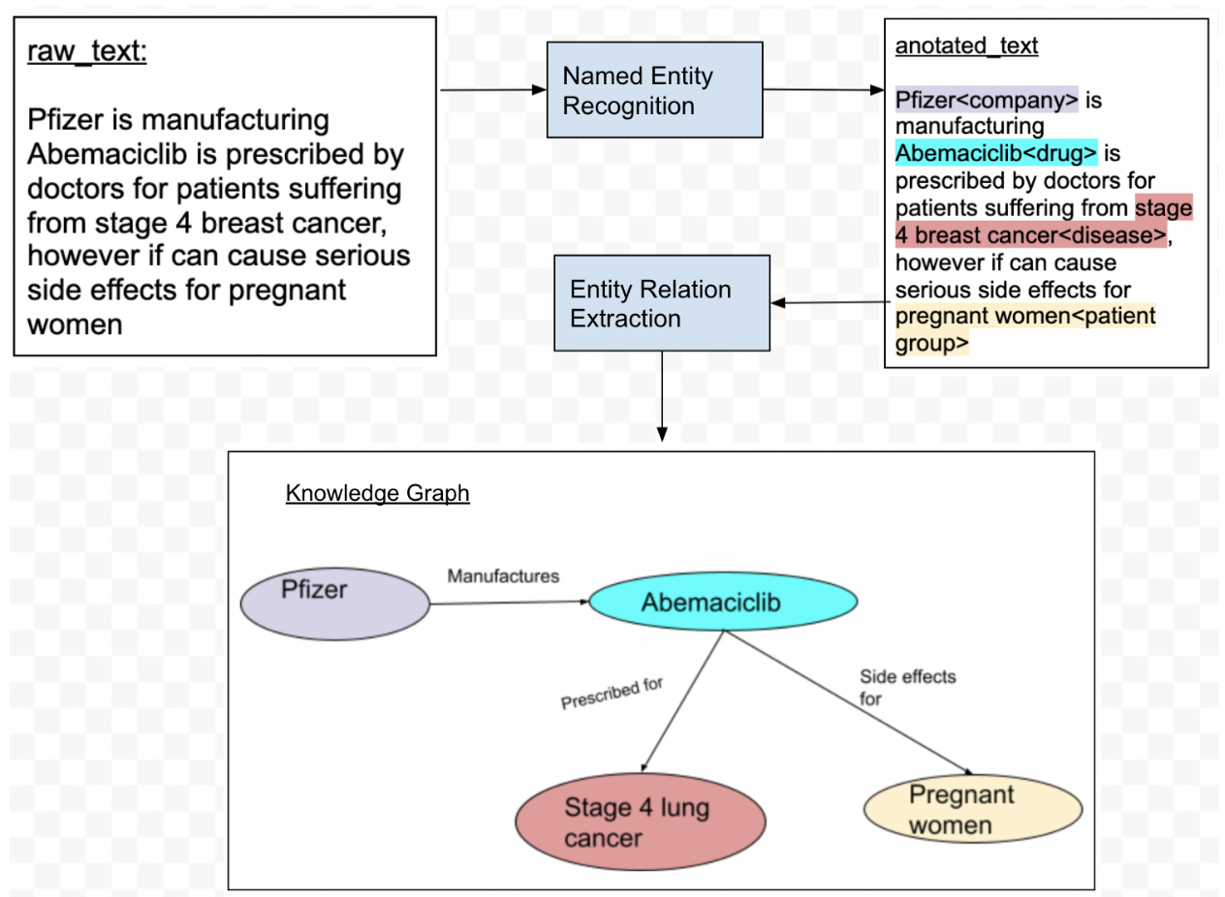
Problem Flowchart

Slide 4
NER Data Set
Dataset with 1M x 4 dimensions
columns include ‘ Sentence', 'Word', 'POS', 'Tag'
Word: Contains English dictionary words forming a sentences
POS: Parts of speech tag
Tag: Standard named entity recognition tags
ex: Organization - Georgia-Pacific Corp., WHO Person - Eddy Bonte, President Obama Location- Murray River, Mount Everest
IOB (inside, outside, beginning) is a common tagging format for tagging tokens.
I- prefix before a tag indicates that the tag is inside a chunk.
B- prefix before a tag indicates that the tag is the beginning of a chunk.
O tag indicates that a token belongs to no chunk (outside)

Slide 5
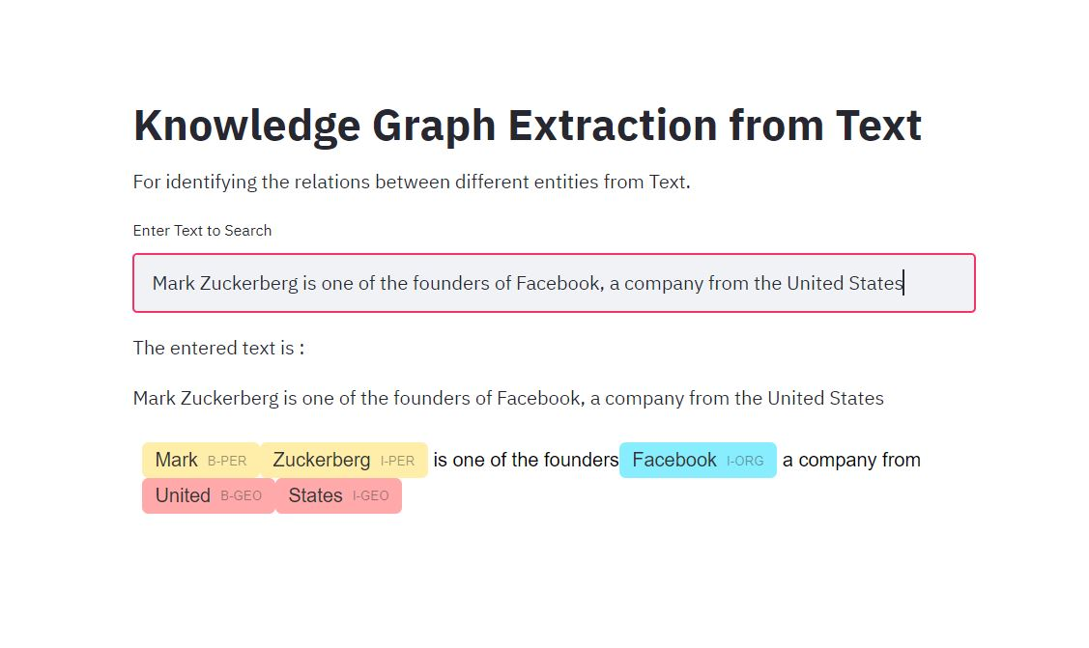
Result

Slide 6
Our Approach - Bi LSTM Model
Classification problem of identifying the names of people, organizations etc
Natural language processing (NLP) technique
Bidirectional long short-term memory is an artificial recurrent neural network architecture
Uses Keras API with TensorFlow as its backend
To build and train a bidirectional LSTM neural network model to recognize named entities in text data
Used in the field of deep learning
Connects two hidden layers of opposite directions to the same output

Slide 7
Our Approach - CRF Model
Often applied in
pattern recognition
machine learning
Conditional Random Fields used for
labeling or parsing of sequential data, such as natural language processing
Training CRF model using sklearn-crfsuite on our data set
Tag assignment depends only on the tag of just one previous word

Slide 8
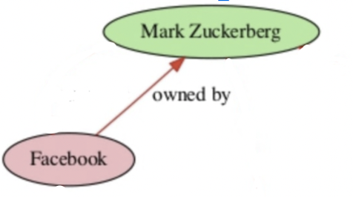
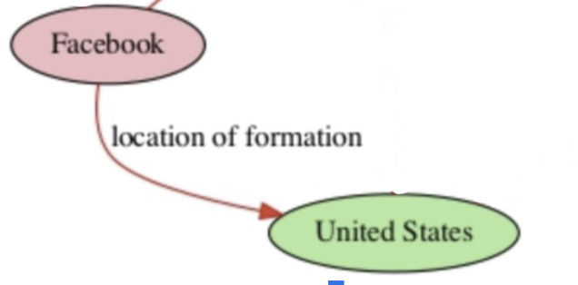
Our Output
Input Tokens & Entities
-Sentence
-Entities
Output of Relation
Notes:
Sentence level

Slide 9
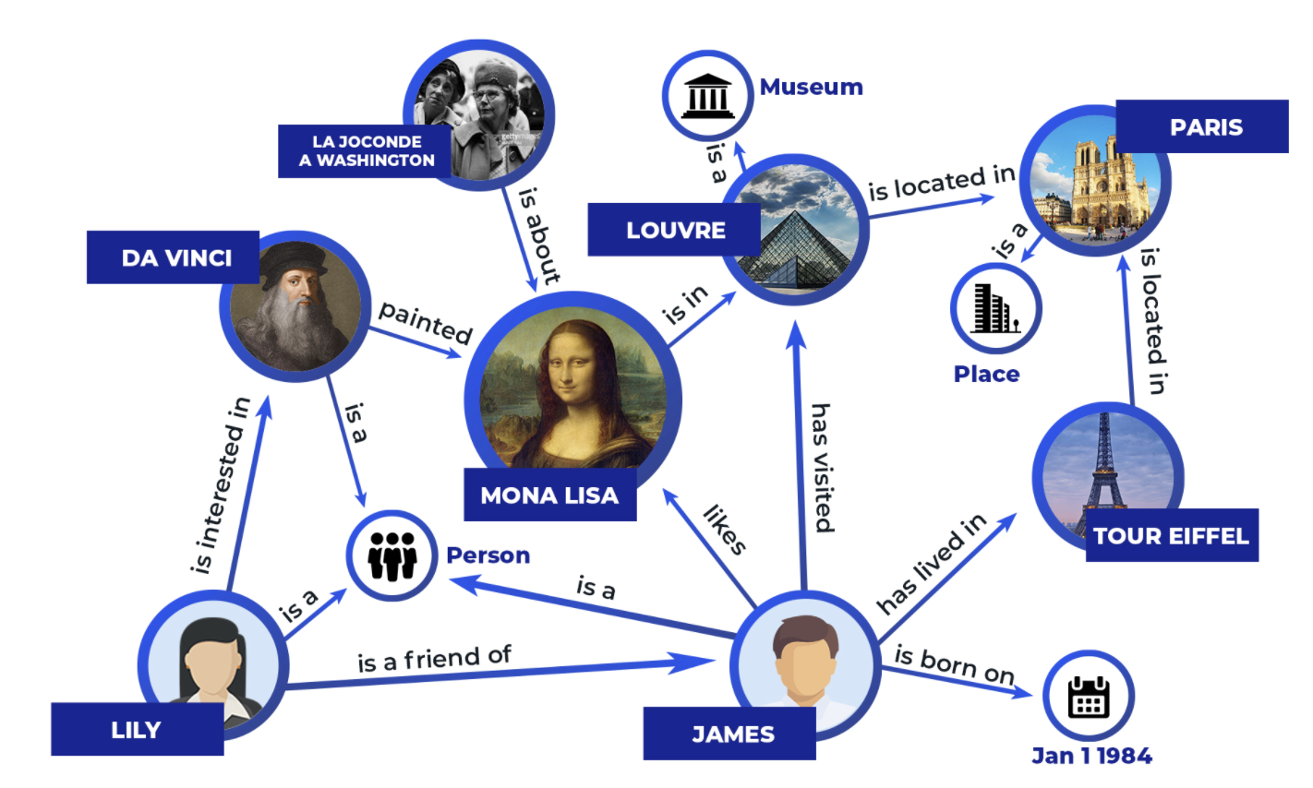
Knowledge Graph
Notes:
Humans can read and understand text but computers cannot, they need a structured repesentation, thats what KG gives us. entities and relationships between them

Slide 10
Relation Extractor - Wiki80 Data Set
Sample training Sentence
{
"token": ["Mark", "Zukerberg", "is", "one", "of", "the", "founders", "of ", "Facebook", ",", "a", "company", "located", "in", "the", "United", "States"],
"head": {
"name": "Facebook",
},
"tail": { "name": "Mark Zukerberg",
},
"relation": "Owned By"
}
56,000 such sentences

Slide 11
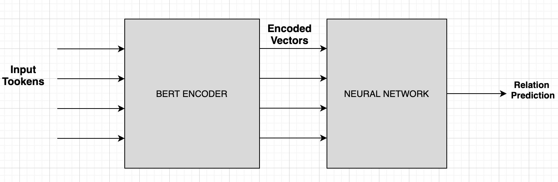
Our Approach
Notes:
In general Machine learning models would have features represented in rows and columns. But in in this case we have plain text or sentences. for this we need something called as Language models. And the most popular Language model we can get is BERT.
we translate them to features by using bert encoding. It gives features in the format that can be trained on by Neural networks

Slide 12
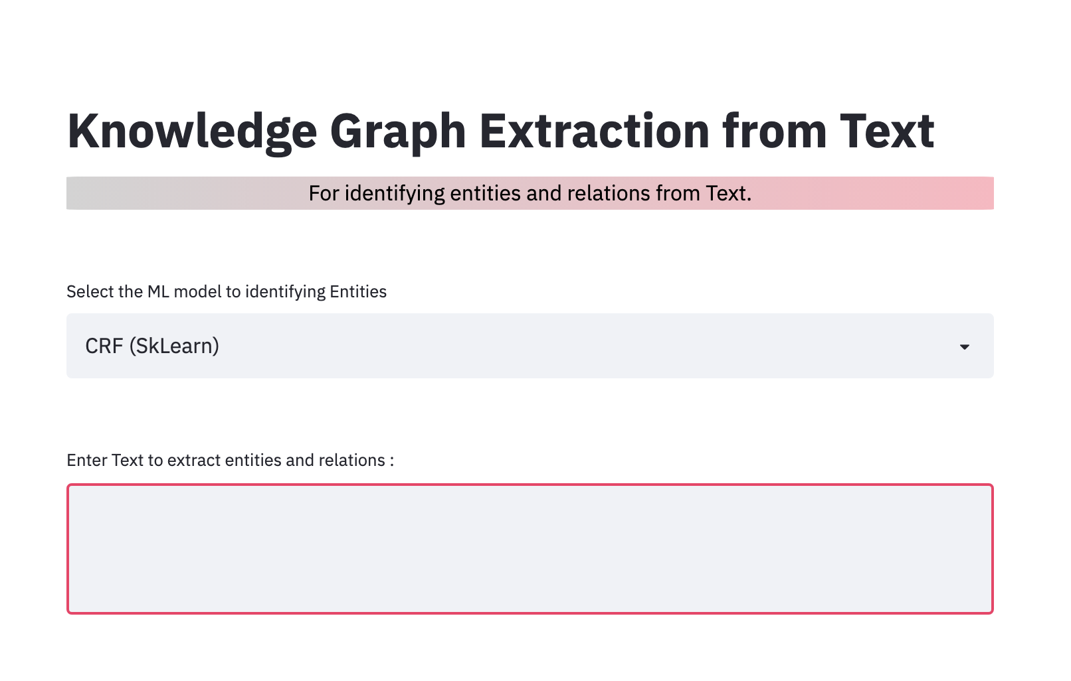
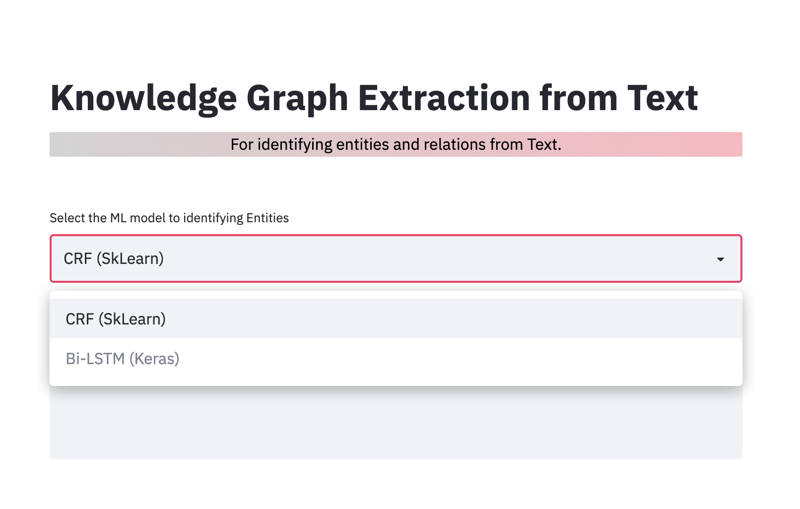
Results – UI (Streamlit)

Slide 13
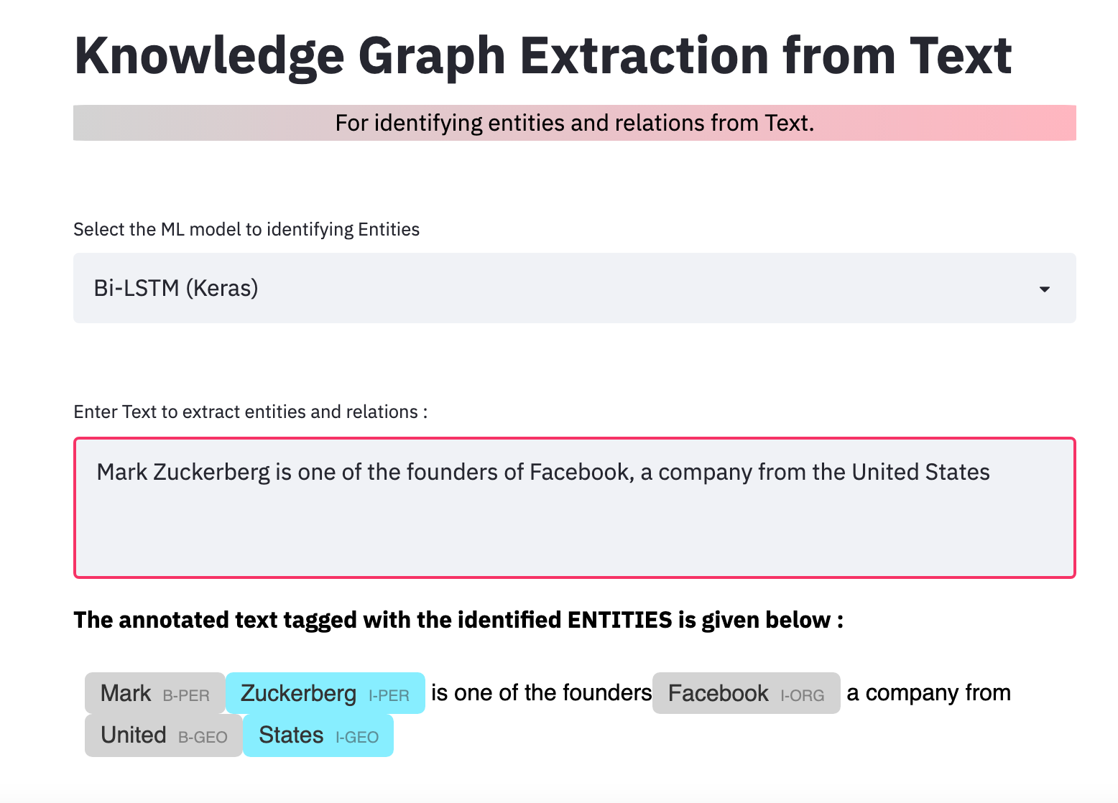
Results – NER using Bi-LSTM

Slide 14
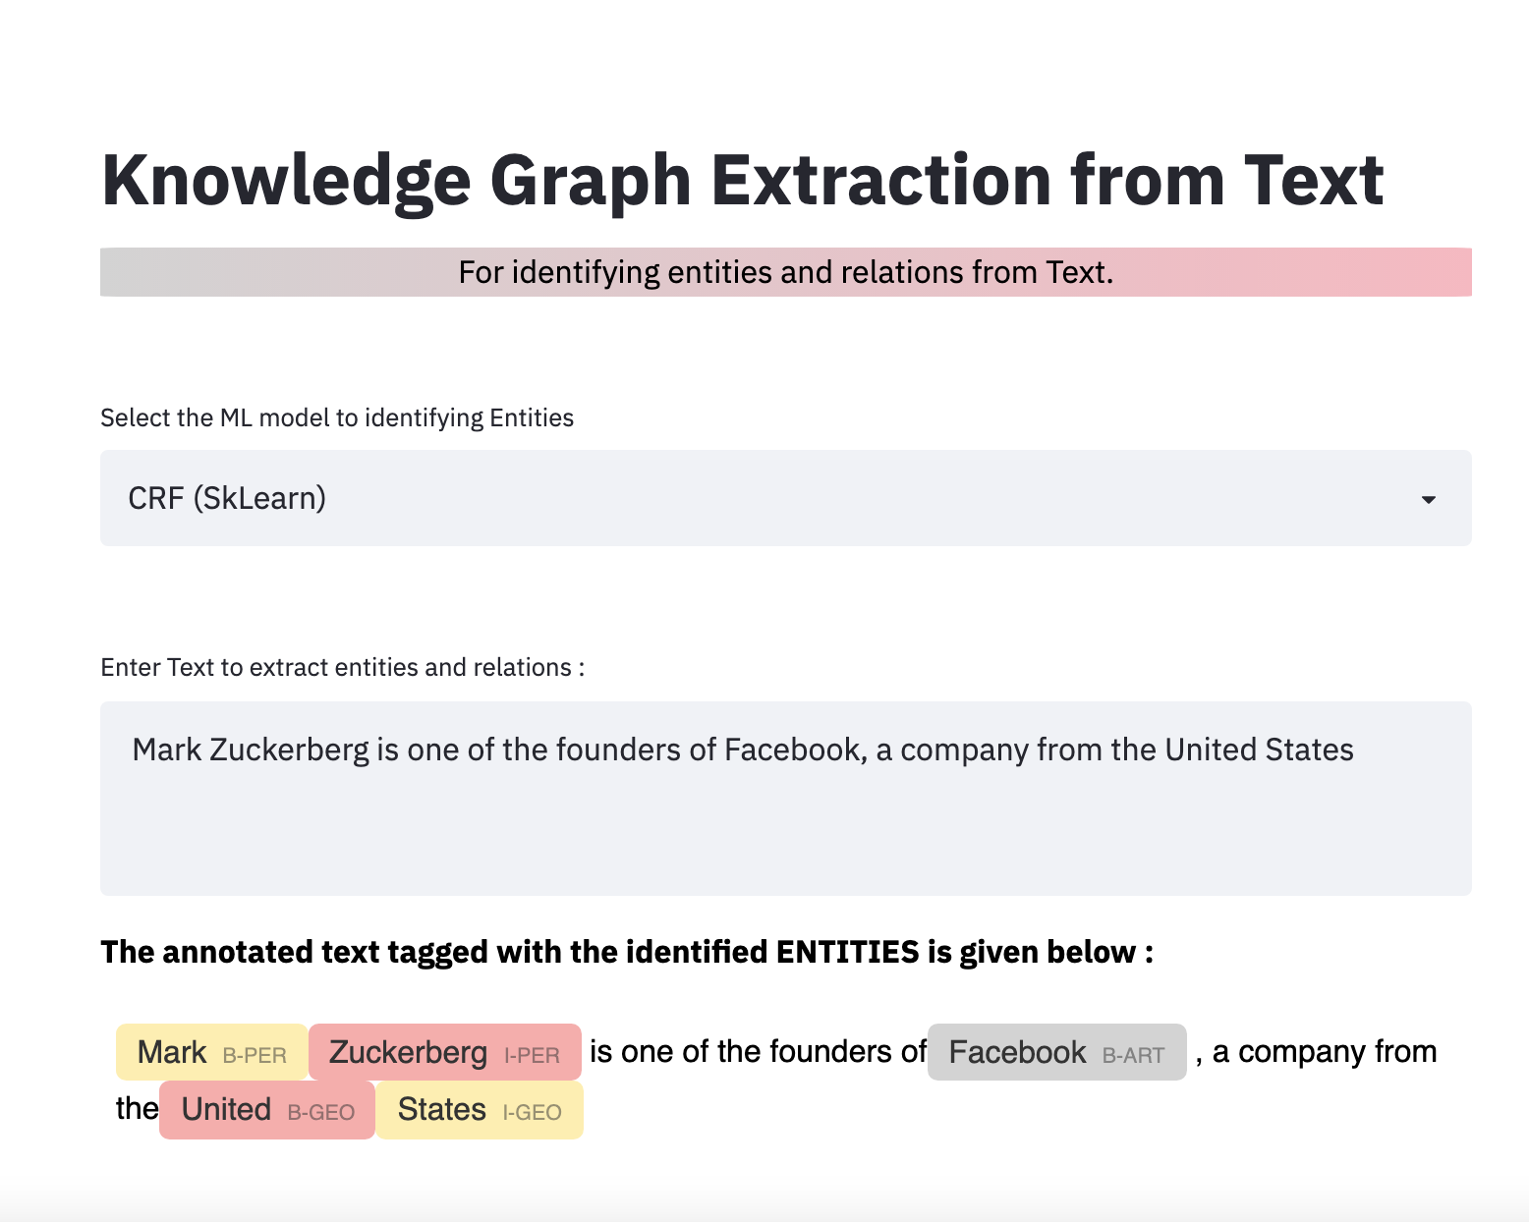
Results – NER using CRF

Slide 15
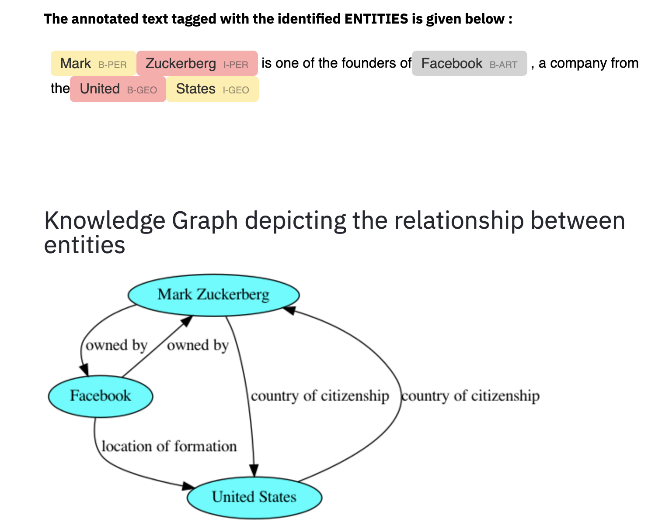
Results – Knowledge Graph Extraction

Slide 16
LIMITATIONS
Trained the NER and Relation extractor on 2 different datasets.
The Bi—LSTM model – slower training and testing.
Unable to reproduce the exact same results with saved and loaded Bi—LSTM model.

Slide 17
ECE 569A – AI Project Presentation
Thank You!!

